Slide 1
IPOL
By Anastacio Malave Iv

Slide 2
My Future
Going into the field of education, now, has become an open possibility for me as well as some other choices that I have thought about.

Slide 3
Influence
For both me and the students it has been a wonderful journey

Slide 4
Project Work

Slide 5
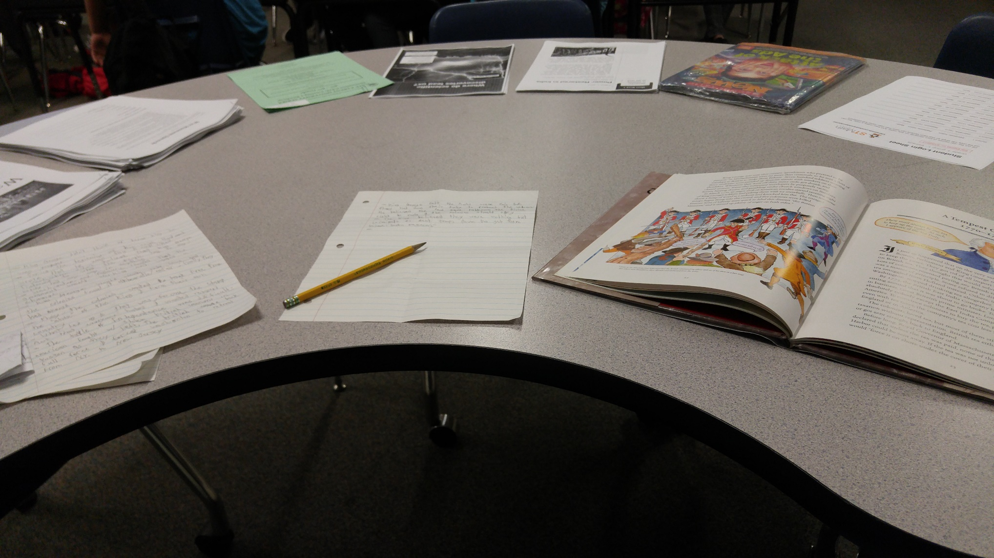
First few days of internship relearning 5th Grade History

Slide 6
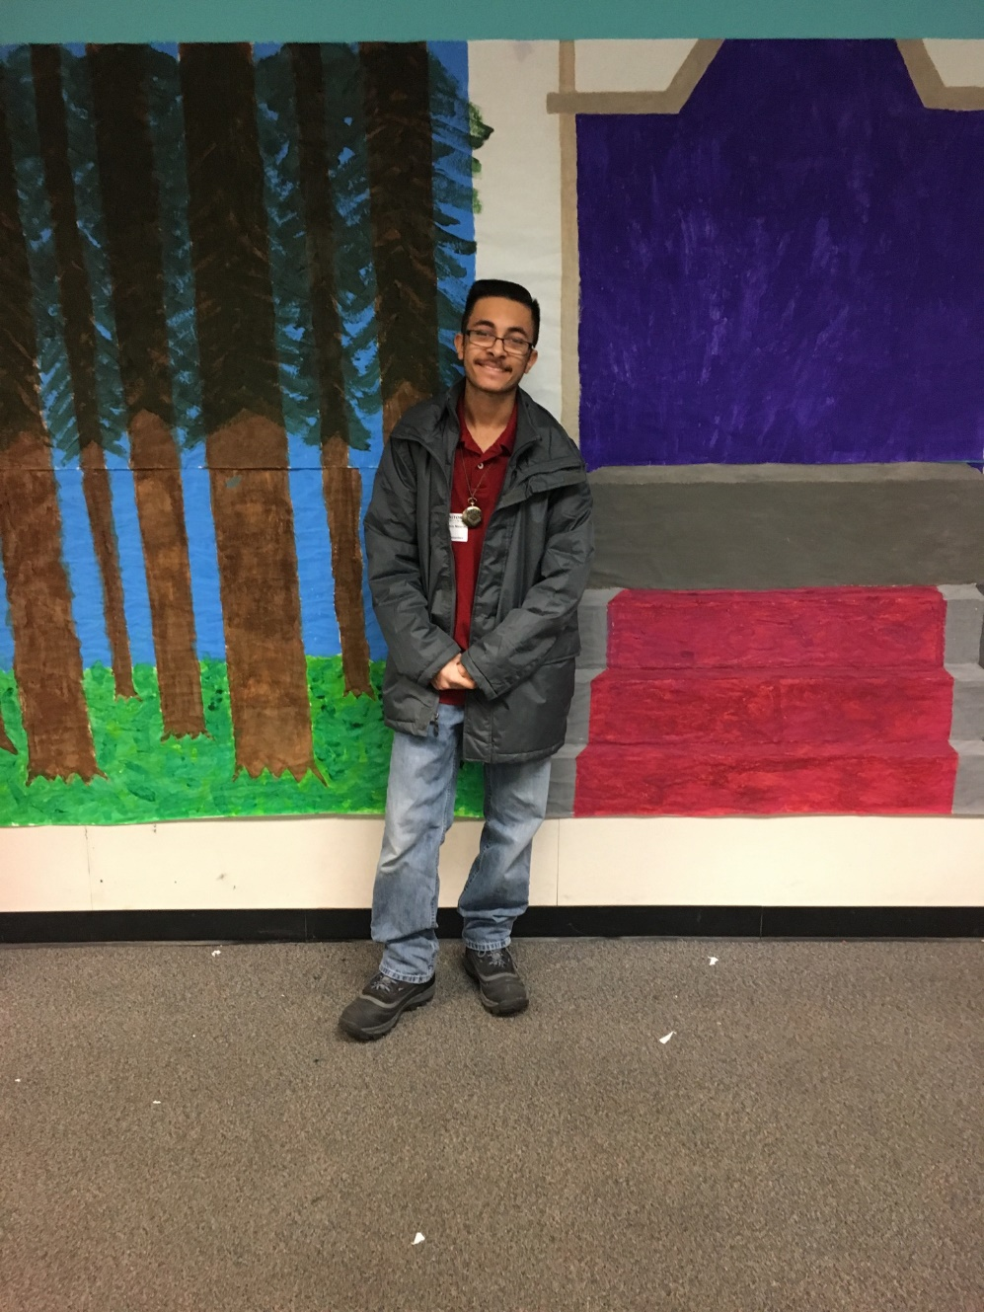
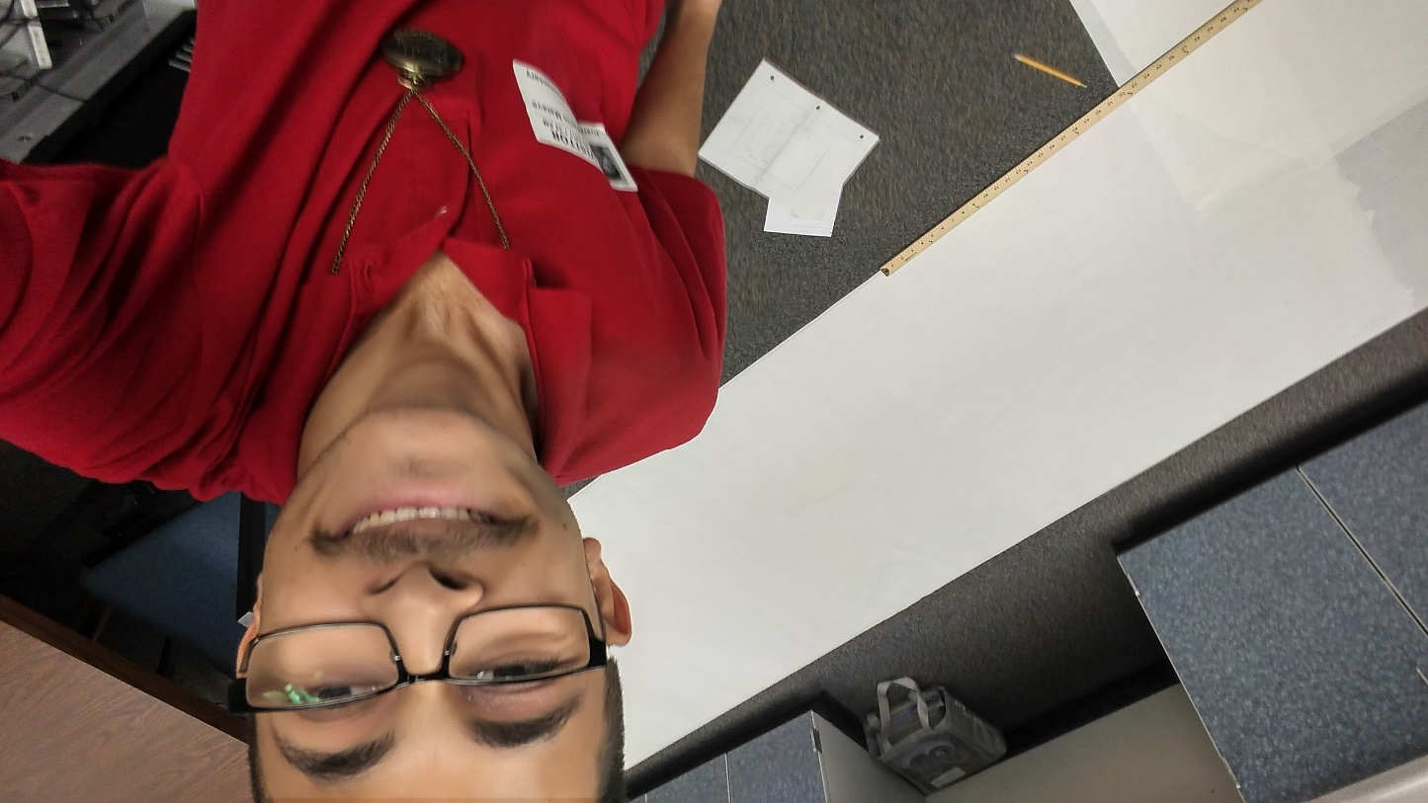
After
Before

Slide 7
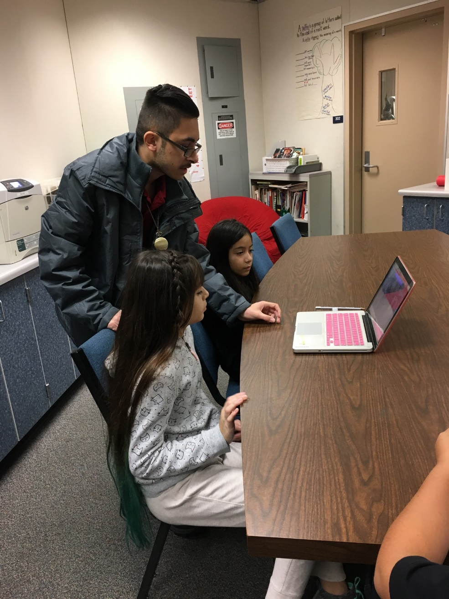
Teaching the fifth graders how to edit the recordings for rap battle.

Slide 8
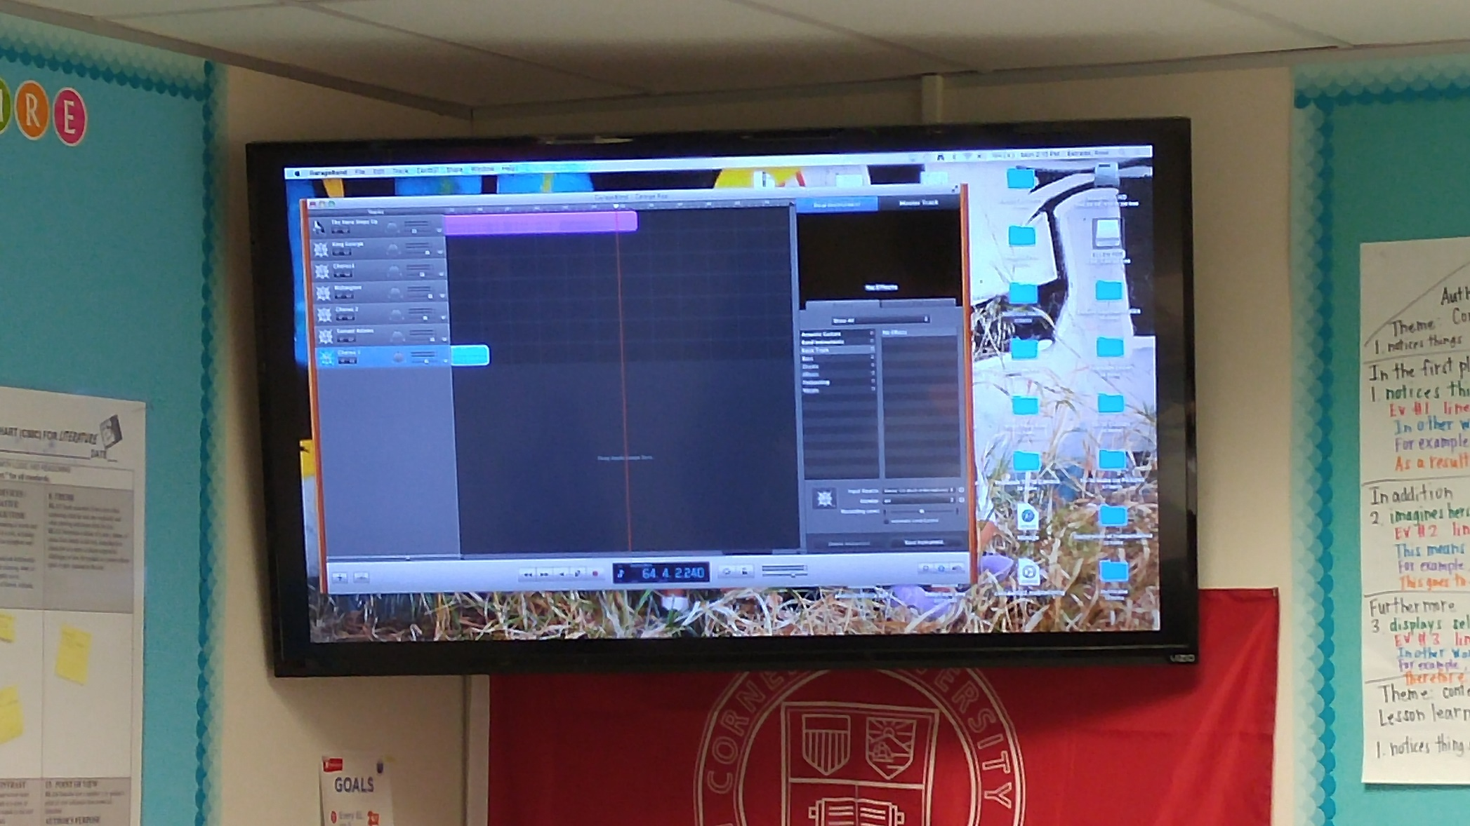
Having the class listen to the final product of the Song

Slide 9
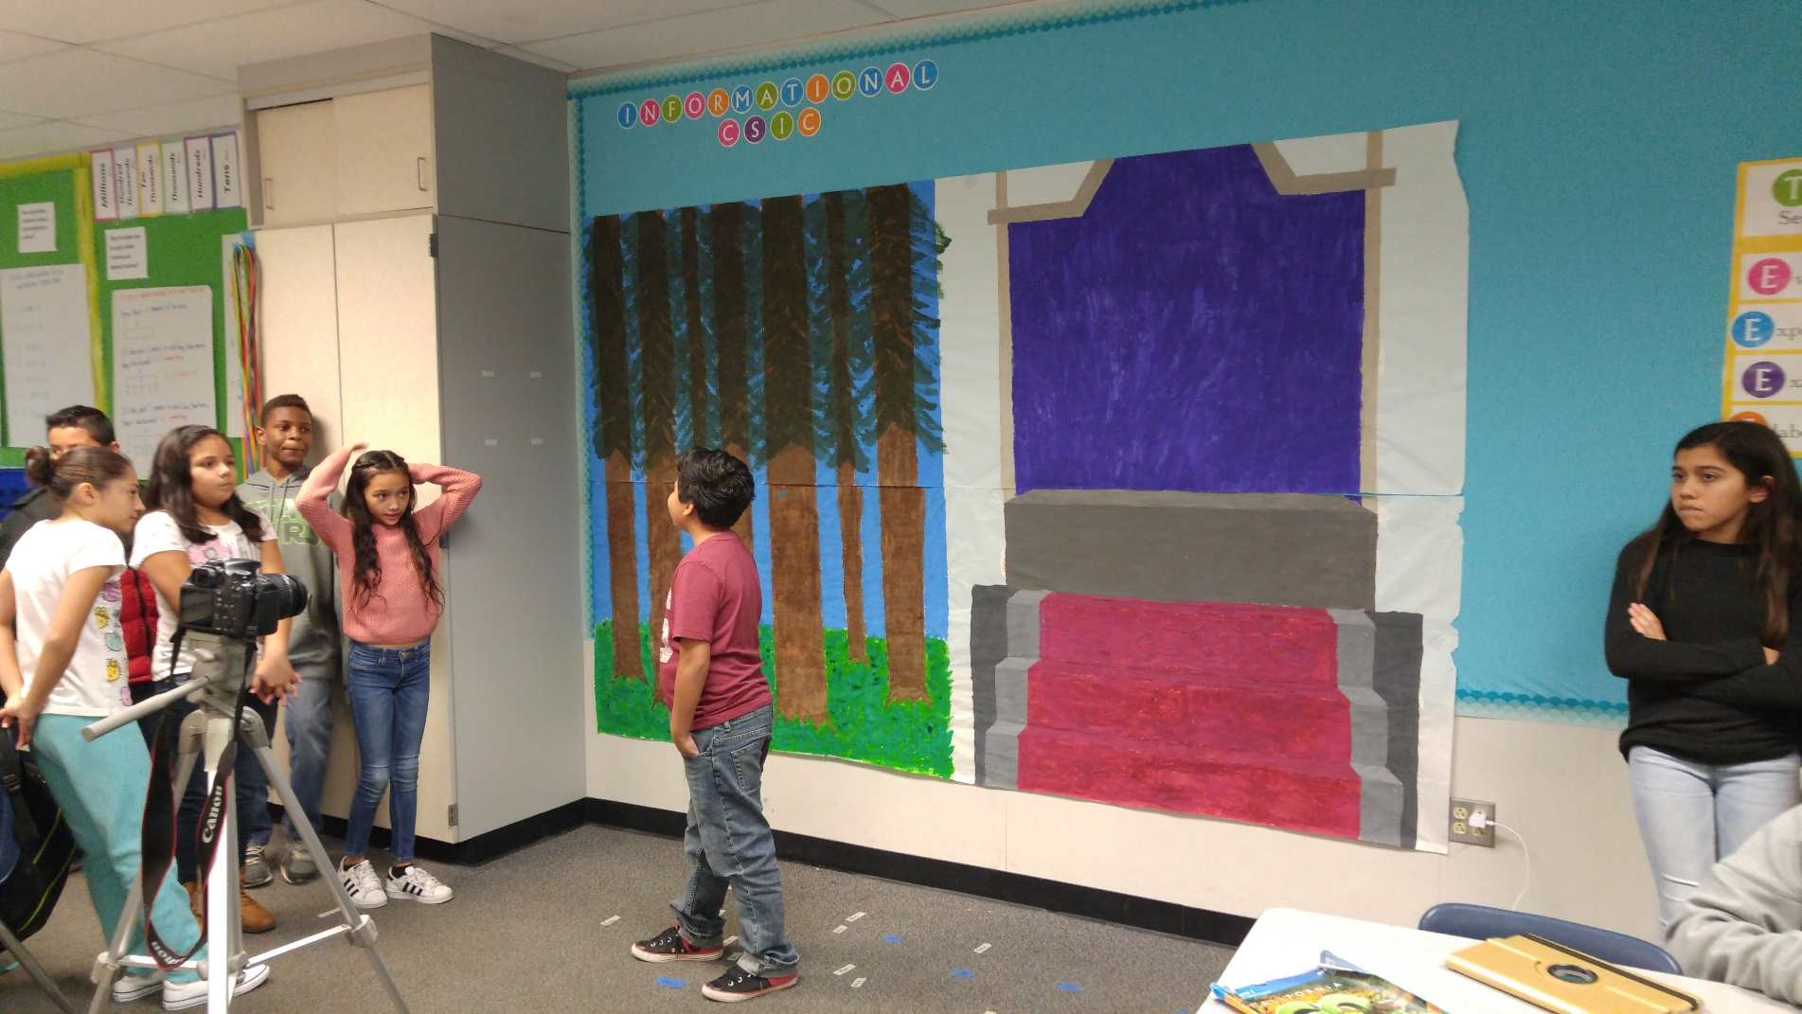
Dress Rehearsal for rap battle

